Slide 1
Retirement Planning and Beyond- A Guide for Business Owners
Presented by:
Gary Cullen- Head of Unio SME
Elizabeth Byrne CFP, Private Client Adviser
September 25th 2025

Slide 2
Retirement Planning And Beyond
Agenda
Introduction Unio & SME team
Key questions from the Business Owner perspective.​
Business Owner Case study
Q&A

Slide 3
We are
300
Employees
€14bn
Assets under investment
30
Years of investment experience
4
Locations: Dublin, Cork, Galway & Limerick

Slide 4



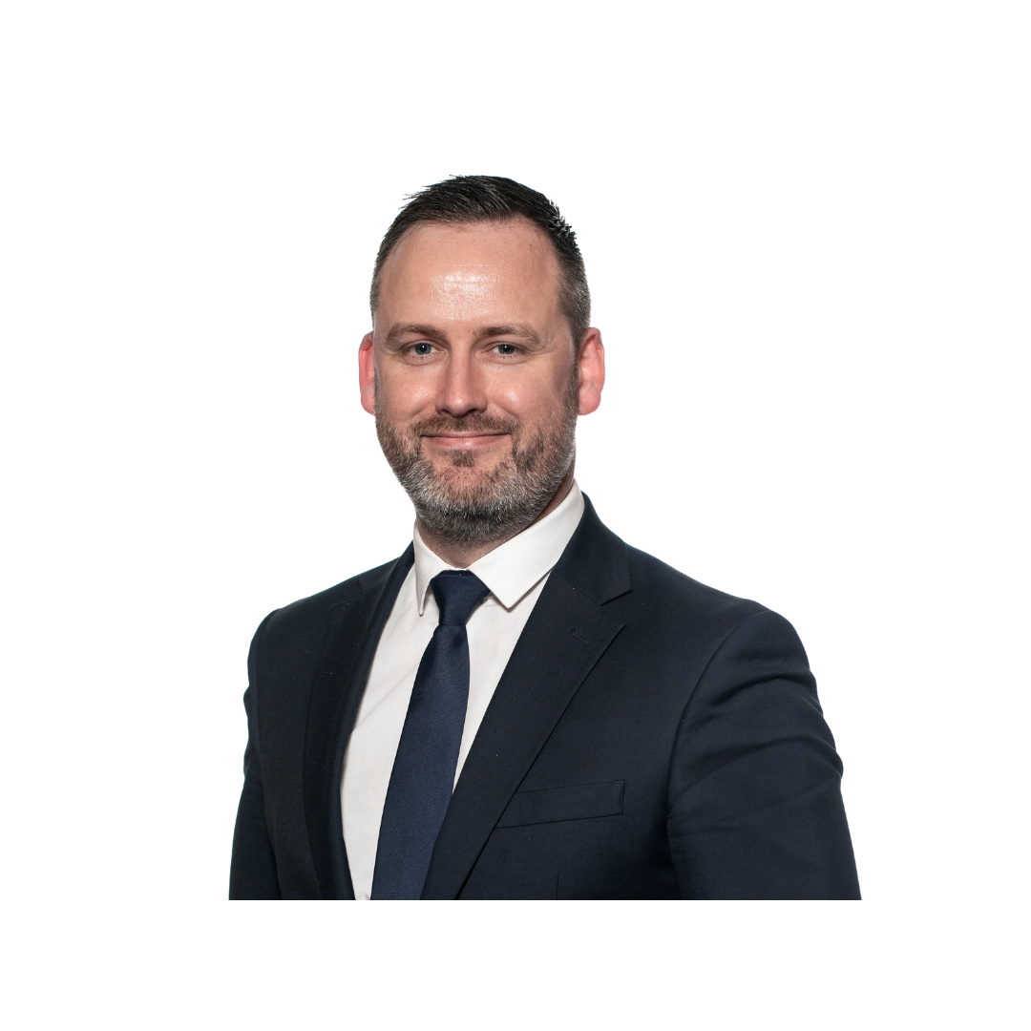

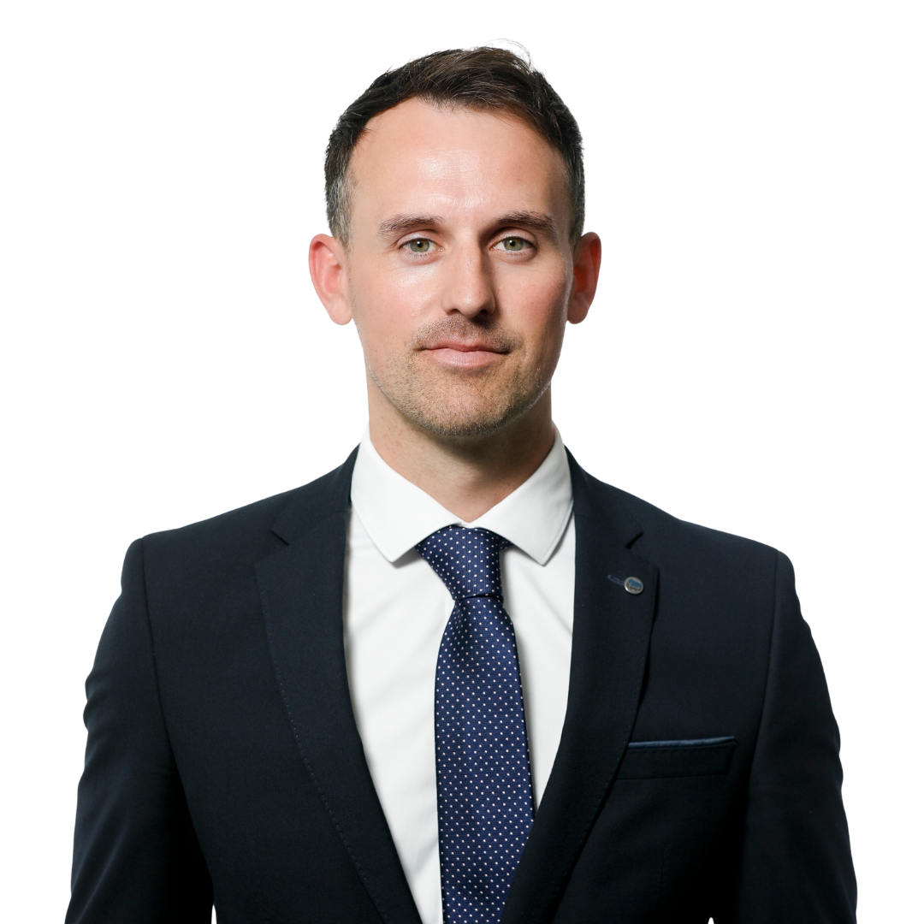

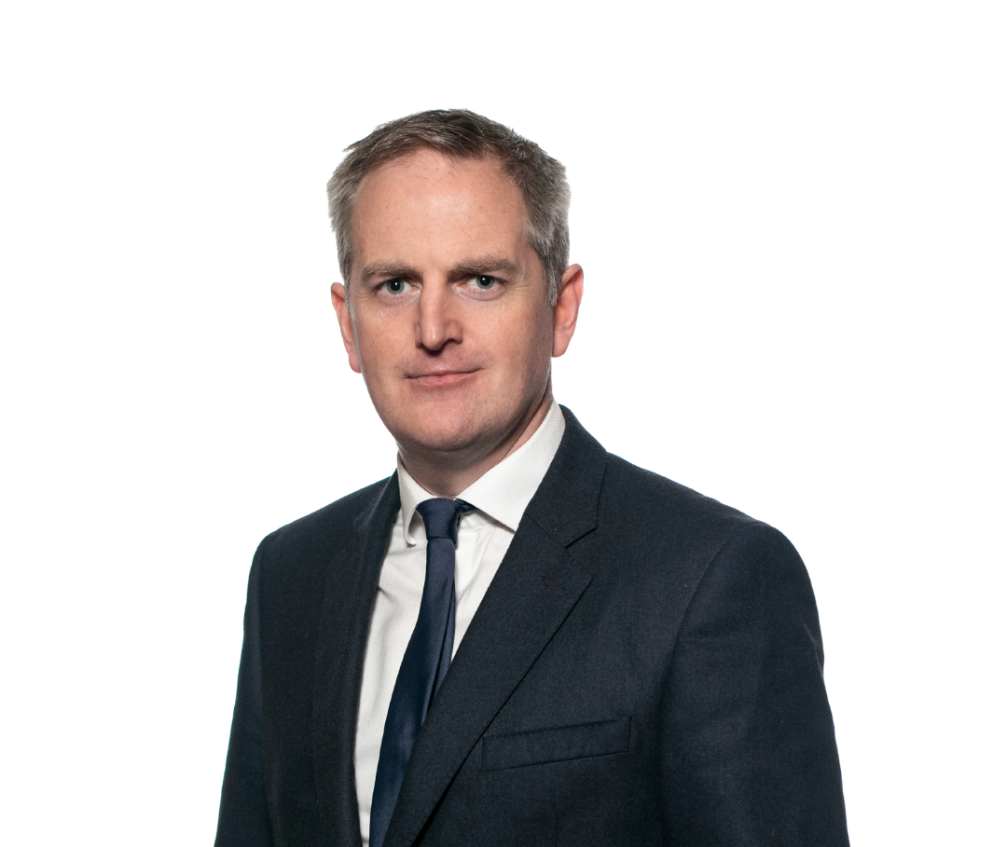






Unio SME Team Our Expertise- Located where you are.
Dublin
Ronan Twomey
Private Client Adviser
Elizabeth Byrne
Private Client Adviser
Greg Cunnigham
Private Client Adviser
Emma May O'Neill
Client Relationship Manager
Peter Walsh
Private Client Adviser
Des Brannigan
Private Client Adviser
Gary Cullen
Head of SME & Business Owners
We have a team of Advisers, solely dedicated to advising business owners and professionals operating in the SME sector in Ireland.
Cork
Diane Skehan
Private Client Adviser
Joesphine Cussen
Private Client Adviser
Robbie Mcdonnell
Private Client Adviser
Galway
John Molly
Private Client Adviser
Philip Byrne
Director-SME & Business Owners
Limerick
Bevan Cantrell
Private Client Adviser

Slide 5
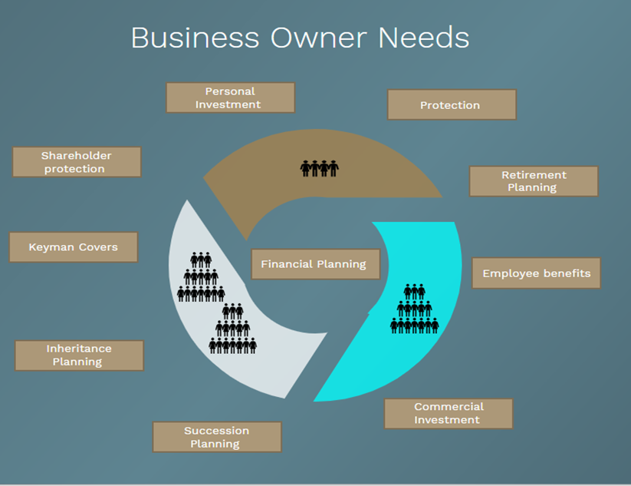
Planning with Purpose

Slide 6
Should my business sale not be my Retirement Plan?
NO. Here is why!
Negotiate from a position of power.
Importance of separating the Individual from the business.

Slide 7
Your Goals

Slide 8
So, how can I get money from my business to fund my retirement plan?
It does depend on your tax status.
Self-employed Vs Company Structure

Slide 9
Self Employed-Schedule D
Income tax relief can be claimed for Net Relevant Earnings (NRE) up to a maximum income of
€115,000 per annum.
Age Attained in Tax Year | % of Net Relevant Earnings
Under 30 | 15%
30-39 | 20%
40-49 | 25%
50-54 | 30%
55-59 | 35%
60 and Over | 40%
Notes:
Emphasise that it is the first time we are seeing it increase, unprecedented situation.
No change to offset for Lump Sum
No change to the amount of the Lump Sum – fixed at 500k not 25%

Slide 10
Much more scope with a company
Company
You
Your Business
% of salary based on age.
Use it or lose it allowance.
Actuarial calculation broadly based 2/3rds final salary funding.
You back fund for previous service.

Slide 11
Company Contributions -Example
Husband
Salary | €100,000
Current benefits | 0
Age | 57
Normal Retirment age | 65
Length of Service | 15
Gender | Male
Marital status | Yes
Back fund | €1,266,714
Annual | €89,517
Wife
Salary | €50,000
Current benefits | 0
Age | 57
Normal Retirment age | 65
Length of Service | 15
Gender | Female
Marital status | Yes
Back fund | €577,603
Annual to 65 | €40,818
Notes:
Emphasise that it is the first time we are seeing it increase, unprecedented situation.
No change to offset for Lump Sum
No change to the amount of the Lump Sum – fixed at 500k not 25%

Slide 12
What's Changing?
Staged increase in the Standard Fund Threshold to 2029
Year | Standard Fund Threshold
2025 | €2 million
2026 | €2.2 million
2027 | €2.4 million
2028 | €2.6 million
2029 | €2.8 million
2030+ | €2.8 million + (linked to a measure of Inflation)
Notes:
Emphasise that it is the first time we are seeing it increase, unprecedented situation.
No change to offset for Lump Sum
No change to the amount of the Lump Sum – fixed at 500k not 25%

Slide 13
Are there tax reliefs and how do they work for me and the company?
Yes, but again it does depend on your status and pension structure type.
Individual Tax Reliefs
Company Tax Reliefs

Slide 14
Tax relief Employee Vs Employer
Who Pays | Employer | Employee
Pension Contribution | €10,000 | €10,000
Income Tax | N/A | N/A
PRSI | N/A | €400 (4%)
USC | N/A | €800 (8%)
Relief Available | €1,250 (Corporation Tax Relief of 12.5%) | €4,000 (Income Tax Relief of 40%)
Net cost to Employer | €8,750 | €0
Net Cost to Employee | €0 | €7,200 (€10,000 – tax relief of €4,000 + PRSI of €400 + USC of €800)
Net Pension Contribution | €10,000 | €10,000
*Assumptions have been used that highest rates of Income Tax, PRSI & USC apply
Notes:
Emphasise that it is the first time we are seeing it increase, unprecedented situation.
No change to offset for Lump Sum
No change to the amount of the Lump Sum – fixed at 500k not 25%

Slide 15
I've heard there are different types of pensions. What's the best option for a business owner?
There are quite a few out there and answer depends on your own unique circumstance.
Occupational pension scheme Vs PRSA
Retained benefits and PRBs

Slide 16
Occupational schemes Vs PRSAs
Occupational | PRSAs
Employer Occupational Pension Schemes. | Typically, a standalone contract for Business Owner.
‘Salary & Service’ Funding Calculation applies. | Max Annual Employer Contribution restricted to 100% of Salary.
Investment Restrictions Apply – max 49% ‘unregulated’ investments. | Insured and Self-Admin PRSAs available.
Notes:
EPP options, then move to discussing ongoing advice

Slide 17
Occupational Scheme Vs PRSAs
 | Occupational Schemes | PRSAs
Earliest Access Age | From age 50 if left that employment | From age 50 but must not be working anywhere else
Latest Access Age | 70 | 75
Death Benefit | 4 x Salary lump sum – balance invested in an ARF or Annuity | Full Fund Payable to the estate on death
Occupational schemes – potentially more generous scope for funding
PRSAs – useful as a planning tool
Notes:
EPP options, then move to discussing ongoing advice

Slide 18
Common to use both
Death Benefit Considerations
Large Single Contributions
PRSA for Accumulated Benefits
Ongoing funding via Master Trust
Existing PRSA
for Regular
Contributions
Master Trust for Large Once Off Contributions
NB! Winding up of Executive Personal Pensions by April 2026.
Get advice don't just default across to a new structure.

Slide 19
Retained Benefits- from previous jobs
Don’t ignore old pensions - include them in your overall retirement planning. Defined Benefit and defined contributions schemes
Transfers may be possible - you might be able to move old pensions into your current scheme, depending on the type.
Combining isn’t always best - some pensions allow access to benefits from age 50, which could be lost if combined.
Review options carefully- consider the pros and cons before making changes

Slide 20
How do I take the benefits when I retire?
There are different options depending on your own unique circumstance.
What age are you and what does retirement really mean?
There is a tax efficient Lump Sum.
Annuity versus ARF

Slide 21
Rules around retirement and what age you can go from.
Retirement is now phased It’s no longer a single event - many people reduce hours gradually over time.
Accessing pensions from age 60 You can begin drawing pension benefits without needing to stop working or sell your business.
Early retirement (from 50 but before 60) – stricter rules To access an occupational pension early, you typically must leave the company and sell any shareholding.
Flexible planning with multiple PRSAs
Holding several PRSAs allows you to draw down benefits at different stages, aligning with your lifestyle.
Notes:
Emphasise that it is the first time we are seeing it increase, unprecedented situation.
No change to offset for Lump Sum
No change to the amount of the Lump Sum – fixed at 500k not 25%

Slide 22
Tax Efficient Lump sum
Depending on your contract type you will either have the option of taking a tax efficient lump sum of either 1.5X Final remuneration or 25% of the fund value.
Broadly speaking, 25% is more common as it allows the remainder be transferred to an ARF.
Tax treatment of lump sums
First €200,000 is tax-free
Next €300,000 (up to €500,000 total) is taxed at 20%
Notes:
Emphasise that it is the first time we are seeing it increase, unprecedented situation.
No change to offset for Lump Sum
No change to the amount of the Lump Sum – fixed at 500k not 25%

Slide 23
Annuity | ARF
Fixed income for life, which may keep pace with inflation (if specifically chosen) | ARF allows the individual to control their funds in retirement, offering them flexibility in how they manage their funds. Can transfer to an Annuity at any point
Can provide a spouse's pension of up to 100% of the pension amount at a reduced initial Annuity payment. | Mandatory Minimum withdrawal of 4% (from age 61) or 5% (from age 71) of ARF value each year. More can also be drawn of needed
Can be guaranteed for a period of up to 10 years, even recipient passes away. | ARF remains invested in the market and exposed to investment risk. Its value may fluctuate up and down depending on investment performance
No ability to pass on any remaining balance to your estate. | Remaining balance of ARF can pass to an ARF in your spouse’s name / can pass to your estate
There is an additional cost to any extras such as inflation protection, guarantee periods or spouse's pension entitlements. | Risk that the ARF may be depleted before you pass away, either due to poor investment management or excessive withdrawals
Notes:
Emphasise that it is the first time we are seeing it increase, unprecedented situation.
No change to offset for Lump Sum
No change to the amount of the Lump Sum – fixed at 500k not 25%

Slide 24
What type of investments are available in pension plans?
There is very wide variety, but it depends on your type of pension structure
Options Available
Impact of any early start & compounding
All Growth is Tax free

Slide 25


Investment Options
Investment | Master Trust Occupational scheme | PRSA | PRB
Individual Cash accounts
Unit linked funds-Cash/Equity/Bonds
Unit linked Property funds
Individual Properties (Residential & Commercial)
Private equity and loan notes
*The above is broad guideline and all investments are assessed individually. Although non-standard assets can be held in a Master Trust impending IORPS legislation will make that difficult in practice.
Notes:
Emphasise that it is the first time we are seeing it increase, unprecedented situation.
No change to offset for Lump Sum
No change to the amount of the Lump Sum – fixed at 500k not 25%

Slide 26
The impact of compounding
John and Mary have built pension funds of similar sizes.
Mary has incurred lower costs, because she has leveraged the power of compounding.
She invested earlier and allowed her pension more time to grow.
 | Mary | John
Regular contribution | €200 per month | €400 per month
Duration | 40 years | 30 years
Investment return | 6% per year | 6% per year
Cost of contributions | €96,000 | €114,000
Value at retirement | €425,331 | €431,523
Notes:
Wendy/Yvonne

Slide 27
So what are your 3 key messages to Business Owners when looking at pensions?
Only 3!!
1. Have a plan for you the individual, give yourself options.
2. Don’t just default to thinking about investment options. Get advice around pension structures too.
3. Compounding & Euro cost average are very powerful so don’t just view a pension as a wealth extraction tool.

Slide 28

Case Study 1
Client profile Ages 57 & 61 Married Grown children – 3 Directors of company, 90%, since 2009, business worth €5-6.5m Executive pensions Pension 1 - €745k Pension 2 - €239k No other preserved benefits | Client Needs Tax efficient retirement advice Pension fund threshold management & flexible phased drawdown advice Shareholder Protection Investment solutions for personal money Tax efficient estate planning advice

Slide 29
Case Study 1
Unio’s approach & Solutions Implemented
Cashflow Modelling | All assets included, providing clear view from now and into the future, includes life events such as retirement, property sales and planned wealth transfers.
Tax Efficient Retirement Planning | Provided technical retirement planning for both: Tom: Plans to work until at least 65. Showed how the business can reach the €2.8m SFT by 65, with the option to stop contributions early. Mary: Wants to retire ASAP. Used maximum funding to extract money from the business, significantly boosting her pension and maximizing her TFLS.
Personal Monies & Investments | Implemented a diversified investment portfolio for excess income to achieve medium to long term growth.
Estate Planning | Given their substantial asset base the clients have ongoing need for tax- efficient wealth transfer. Maximised annual tax-free gifting – €3,000 per person per year to children, grandchildren, in laws. Established section 72 & 73 life policies and savings.

Slide 30


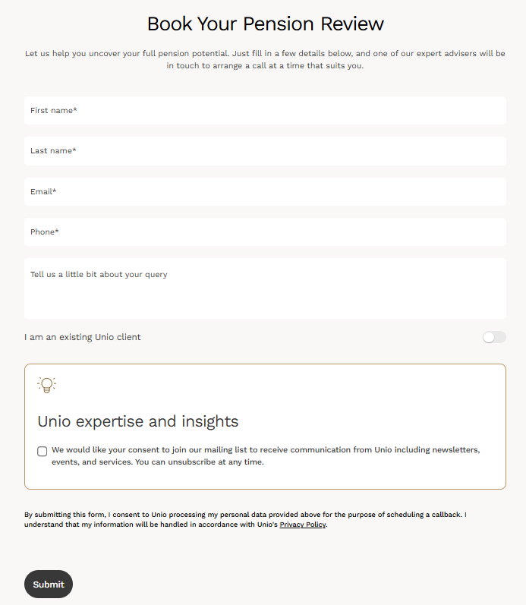
Next Steps
Interested in a pension review? Your details will be submitted directly to a Unio wealth adviser for a consultation.
unio.ie/pensions2025

Slide 31
Q&A..
Notes:
My question is OK . Yes, so note that exemption for members of a pension scheme who are contributing. May have option to make membership mandatory, or set up a scheme if not in place. Remove restrictions and allow access from day 1. set own contribution levels for now.
Q2:
Yes, they can, we often see this done for key employees or family members/spouses. Opportunity to fund up 800k tax free lump sum or further, particularly if business owner themselves is over the sft. Has to be genuine employment taking a salary etc but normal limits apply i.e. 100% of salary for PRSA, salary/service for MT. another way to extract cash tax-efficiently from a company – should be done in conjunction with overall financial/business plan.

Slide 32
Thank You

