Slide 1

ISME Skillnet is pleased to offer this Training Course
The ISME Skillnet is partially funded by member companies and the Training Networks Programme, an initiative funded from National Training Fund.
To avail of this public funding and the discounted fee for the training, participants are required to an Evaluation Sheet which will be sent after the event.
It is also important to be aware, that you may be contacted by an independent Quality Assurance organisation to verify that you have attended the course and to check the quality of the course.
We hope that you enjoy the programme and find it worthwhile.

Slide 2
CCTV and the GDPR

Slide 3


Health Warning!
Notes:
I’m not here to tell you that it’s easy, that everything will be okay, or that you need not do anything. Equally, I did not develop the GDPR – so don’t shoot the messenger. Ultimately, the purpose of this session is to give you a sense of what needs to be done to ensure that CCTV brings you the benefits you are looking for, and not just a great deal of future trouble.

Slide 4

Firstly…what is personal data and why is it protected?

Slide 5
What is “personal data”?
“Information relating to an identified or identifiable natural person”

Slide 6

Images are direct identifiers

Slide 7
What is “personal data protection”?
Not just security or confidentiality.
Use of personal data fairly for specified purposes.
Use of personal data on the basis of the consent of the person concerned or some other legitimate basis laid down by law.
The right of access to data which has been collected concerning him or her, and the right to have it rectified.
Notes:
Lawful use; transparency; limitations on use; data minimisation; accuracy; retention; rights

Slide 8
In short, you can’t capture personal data and use it in any way you like

Slide 9




Key terminology
Data subject
The individual who is the subject of personal data.
Processing
Anything we do with personal data.
Data controller
Anyone who controls the content and use of personal data obtained from data subjects.
Data processor
Anyone who processes personal data on behalf of a data controller, but not an employee of a data controller who processes personal data as part of their job.

Slide 10

CCTV – getting the GDPR basics right

Slide 11
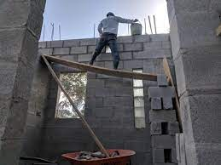
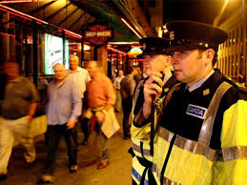
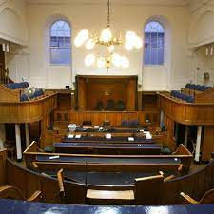
Identify a clear purpose for CCTV
why do you need to use CCTV?
Notes:
Critical for the next step, which is to determine whether the use of CCTV is necessary and proportionate by reason of its effectiveness

Slide 12
Is the use proportionate and necessary?
Why is the use of CCTV necessary?
Will the use of CCTV be effective?
Why do the benefits of using the CCTV outweigh the privacy rights of the data subjects?
Notes:
Why is it necessary in the context of the purpose. Can the outcome desired be achieved in different ways? Is the outcome legitimate?
Will CCTV achieve the purpose – how effective is it in that context?
How is the use of CCTV balanced against the rights of the people affected?
These need to be considered: it is necessary because; it is proportionate because; its benefits are…

Slide 13

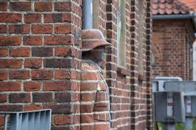
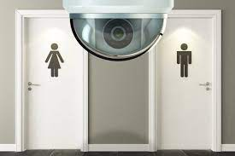
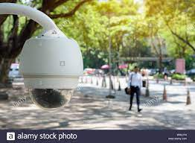
What CCTV use will be difficult?
Over-surveillance
Covert -surveillance
Intrusive -surveillance
Surveillance of public areas
Notes:
These things are far less likely to meet the standards for being proportionate and necessary.
Over-surveillance: more than is needed to meet the purpose
Covert – surveillance: people don’t know it is happening
Intrusive – the privacy rights of the individuals are being infringed
Public areas – not your premises (keeping an eye on someone else in case they do something)
But it can depend on the purpose for the CCTV and what you are trying to achieve – but ultimately the privacy rights of the individual is a difficult hurdle to overcome.

Slide 14
Adopt and document a lawful basis
You must have a documented, lawful basis for processing. Most likely to be:
necessary to comply with a legal obligation
necessary in the legitimate interests of you or a third party
Legitimate interest assessment:
what is the legitimate interest
why is it necessary
balancing test
safeguards and compensating controls
Notes:
Legal obligation – what is it and is it necessary to comply with it. Most likely to apply for use of CCTV in context of health and safety.
Legitimate interests – only permitted if not overridden by the interests or fundamental rights and freedoms of the data subject, which require protection of personal data – means a legitimate interest assessment must also be undertaken.

Slide 15
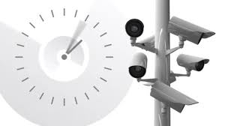
Define a retention period
Don’t keep images for an excessive period (or forever)
Don’t just rely on overwrite
Decide in what circumstances specific images need to be kept for longer, and why
Notes:
What is an appropriate period can depend on the purpose for which the images are used.
A general retention period beyond a month may be difficult to justify.

Slide 16
Complete an impact assessment
Advisable in all cases, but legally required if the CCTV systematically monitors publicly accessible areas on a large scale. Intended to identify the impact and the risks associated with data processing and ensure they are addressed. Will include:
Risks associated with the life cycle of the CCTV data and the associated business processes
Risks associated with the assets or third parties used in the business process
Whether the processing is necessary, effective and outweighs privacy rights
Identify and document the lawful basis of processing
Identify how the CCTV data collected is minimised to that which is necessary for the purpose
Retention period
Controls to protect the personal rights of data subjects
Data security risks

Slide 17

Telling people about the CCTV
Must provide people with notice of the CCTV and where they can get further information
Further information = a transparency notice. This could be on a web page, in the employee manual or other accessible or available document.
Transparency notice must include:
Identity and contact details of the data controller
Contact details for the data protection officer, if one has been appointed
The purposes for which the CCTV is used
The legal basis for the processing
Third parties the footage is shared with
The retention period for CCTV footage
The existence of data subject rights and the right to lodge a complaint with the Data Protection Commissioner
Notes:
Strategic / existential risk: less about fines, more about revenue and value! Use recent examples!

Slide 18
Managing data subject rights
Decide in advance how to deal with data subject rights:
Subject access requests (whilst not disclosing other people’s personal data)
Deletion
Objection to processing
Objection and deletion are particular issue if using CCTV under the “legitimate interest” lawful basis
Notes:
If legitimate interest, data subject can object to processing; if so, and there is no overriding legitimate grounds for processing, right to erasure can be applied; can also require restriction of processing if it is objected to pending verification of overriding interest.

Slide 19
Document everything!
Write down and document your decisions and rationale
Maintain a Record of Processing Activity

Slide 20
CCTV – other things to consider

Slide 21

Have a policy
If you are using CCTV extensively,
consider a CCTV policy!

Slide 22

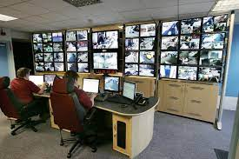
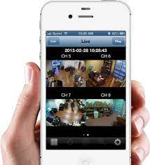
Data processors?
Third party operated systems or assets to manage or host CCTV footage:
Data hosting Monitoring services Viewing apps

Slide 23
Data processors?
Data processing agreement
No transfers of personal data outside of EU (watch out for mobile apps!)
Identify them in the DPIA and Record of Processing Activity

Slide 24
CCTV vendors
They are there to sell you CCTV solutions, not provide data protection guidance
Unfortunately, our experience is the advice they do give is often wrong or inadequate*
*This is not true in all cases and not intended to be a specific statement in respect of any particular vendor.

Slide 25
Security
Make sure CCTV images are kept secure:
Confidentiality
Integrity
Availability
Personal data breaches need to be reported!

Slide 26
Procedures
Document and implement procedures around the collection and use of CCTV.
Storage
Accessing
Viewing
Use of CCTV images
Transfers to third parties
Security measures
Dealing with data subject rights
Notes:
These should reflect the risks identified in the DPIA, and the need to ensure data protection requirements (six principles) are adhered to. Also needs to ensure security.

Slide 27

CCTV in court

Slide 28
Can CCTV be used in Court?
Yes:
Regardless of the basis for its collection and use, Section 41 of the Data Protection Act 2018 says personal data can be used when it:
is necessary for the purposes of providing or obtaining legal advice or for the purposes of, or in connection with, legal claims, prospective legal claims, legal proceedings or prospective legal proceedings, or
is otherwise necessary for the purposes of establishing, exercising or defending legal rights.
Section 41(c) – Data Protection Act 2018

Slide 29
Can CCTV be used in Court?
BUT:
This doesn’t mean you can use it for other purposes it wasn’t originally collected for (e.g. using CCTV footage intended for preventing Health & Safety incidents in connection with disciplinary proceedings for theft)
It also doesn’t mean that a data subject cannot object to its use or otherwise exercise their rights in respect of the personal data

Slide 30
Can CCTV be used in Court?
SO:
When deciding to use CCTV and considering its necessity, proportionality and lawful basis for use, consideration needs to be given to all the intended purposes of use.

Slide 31
Disclosure or deletion of CCTV footage?
Data subjects may want to see CCTV footage through a data subject access request. Can the request be refused?
Generally, speaking: NO
However, in the context of litigation, Section 60 of the Data Protection Act 2018 allows the possibility for refusing disclosure, deletion, (etc):
in contemplation of or for the establishment, exercise or defence of, a legal claim, prospective legal claim, legal proceedings or prospective legal proceedings whether before a court, statutory tribunal, statutory body or an administrative or out-of-court procedure

Slide 32
Disclosure or deletion of CCTV footage?
BUT:
Can’t use this exception just in case the request is leading to a claim
Withholding has to be necessary and proportionate in the context of a legal claim
The data subject has to be told clearly why the personal data is being withheld
Litigation disclosure rules will also be applied (separately)
Notes:
The restriction can only be applied where there is a legal or civil law claim contemplated or in progress. This means considering each request on a case-by-case basis to make clear, documented judgements as to whether the request is made in the context of a legal claim. A policy decision that all requests should be refused on the basis of the exception will not fulfil the requirements of the exception.
Withholding personal data (in this case, CCTV footage) would need to be both necessary and proportionate in the context of a legal claim. Necessity and proportionality should, in my view, be supported by clear advice from the solicitor who would be (or is) defending the action setting out why disclosing the personal data would be prejudicial to the data controller, and why that prejudice outweighs the rights of the data subject. In this respect, I do not see any difficulty in that advice having some grounding in the rules of disclosure, but the advice would also have to consider the impact of the disclosure (for example, if the CCTV clearly demonstrated that a prospective claim is bound to fail, then as it supports the controller withholding it may not be necessary or proportionate). It is important to note that the necessity and proportionality for withholding needs to be considered separately for each category of personal data being withheld.
Having made a decision to withhold personal data, that must be communicated to the data subject together with the reasons why the personal data is being withheld (within the one month period from receipt of the request).

Slide 33

Consequences

Slide 34
If it goes wrong?
May not be able to use the CCTV footage
Intervention from the Data Protection Commissioner
Requirement to stop using CCTV
Claims from data subjects
In the worst case scenario, regulatory penalties

Slide 35

Round up

Slide 36
Round up
Think carefully before deploying CCTV
Make sure its use is necessary, proportionate, and lawful
Make it clear CCTV is being used and provide detailed information
Prepare for dealing with data subject rights
Document your decisions
Document relevant policies and procedures
Get help when needed

Slide 37

Sources of help

Slide 38
Sources of help
CCTV Guidance for Data Controllers (Data Protection Commission):
https://www.dataprotection.ie/sites/default/files/uploads/2019-10/CCTV%20Guidance%20Data%20Controllers_October19_For%20Publication_0.pdf
Data Protection Impact Assessments (Data Protection Commission)
https://www.dataprotection.ie/en/organisations/know-your-obligations/data-protection-impact-assessments

Slide 39
www.impactprivacy.com
leon.atkins@impactprivacy.com
+353 (0)86 045 4704

Slide 40

Thank You for attending
We hope that you found the Course beneficial!
Please ensure that you complete and return the feedback form.
Reminder: You may receive a call from an independent QA organisation to verify that you have attended the course and to check the quality of the course.

